Slide 1
Java Script

Slide 2

Why we need JavaScript?
When an application is loaded on the browser, there is a 'SignUp' link on the top right corner.

Slide 3
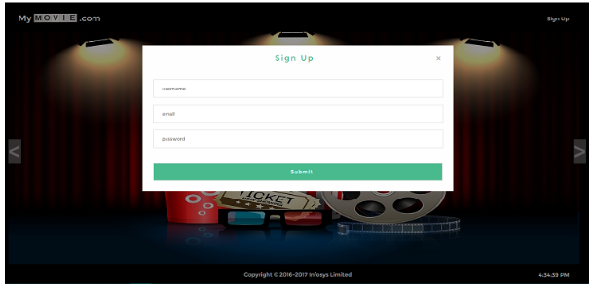
When this link is clicked, the 'SignUp' form is displayed. It contains three fields - 'Username', 'Email', and 'Password' and in some cases a 'Submit' button as well.

Slide 4
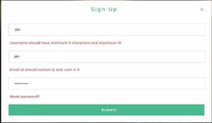
When data is entered in the fields and the button is clicked, then data entered in the fields will be validated and accordingly, next view page loaded. If data is invalid, an error message is displayed, if valid, the application navigates to homepage.

Slide 5
How to handle the user click, validate the user data, and display the corresponding view?
To implement the requirement of handling user action like a click of a button or link and to respond to these requests by displaying the expected output, server-side languages like Java/JSP can be used.

Slide 6
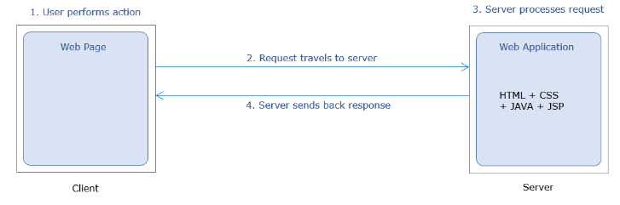
Server-side languages have certain limitations :-
Multiple request-response cycles to handle multiple user requests
More network bandwidth consumption
Increased response time
If client-side scripting language JavaScript is used then, this can be done without consulting the server.

Slide 7
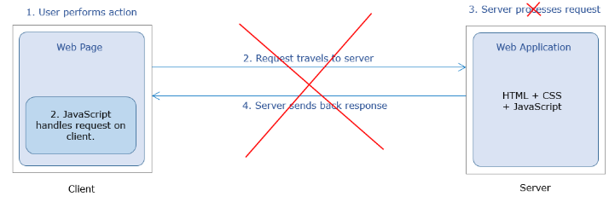
The home page of MyMovie.com contains the SignUp link. The user performs click action on this link.
The user action is handled on the client side itself with the help of the JavaScript code. This code arrives on the client along with the home page of the application.

Slide 8
Advantages of using JavaScript
No need for back and forth request-response cycles
Less network bandwidth consumption
In comparison to Java: JavaScript provides a 35% decrease in average response time and Pages being served 200ms faster.

Slide 9
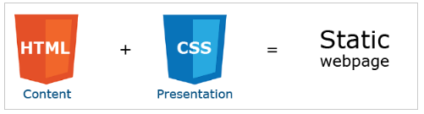
What is JavaScript?
JavaScript is the programming language for web users to convert static web pages to dynamic web pages.
Web page designed using HTML and CSS is static.

Slide 10

JavaScript combined with HTML and CSS makes it dynamic.
JavaScript was created as a scripting language in 1995 over the span of 10 days with the name 'LiveScript'.
Now, JavaScript is a full-fledged programming language because of its huge capabilities for developing web applications.

Slide 11
It contains core language features like control structures, operators, statements, objects, and functions.
JavaScript is an interpreted language. The browser interprets the JavaScript code embedded inside the web page, executes it, and displays the output. It is not compiled to any other form to be executed.

Slide 12
Where to write JavaScript code?
JavaScript code can be embedded within the HTML page or can be written in an external file.
There are three ways of writing JavaScript depending on the platform :
Inline Scripting
Internal Scripting
External Scripting

Slide 13
Internal Scripting
When JavaScript code are written within the HTML file itself, it is called internal scripting.
Internal scripting, is done with the help of HTML tag : <script> </script>
This tag can be placed either in the head tag or body tag within the HTML file.

Slide 14
JavaScript code written inside <body> element is as shown below :
<html>
<head>
</head>
<body>
<script> //internal script </script>
</body>
</html>
JavaScript code written inside <head> element is as shown below :
<html>
<head>
<script>
//internal script
</script>
</head>
<body>
</body>
</html>

Slide 15
External Scripting
JavaScript code can be written in an external file also and is saved with the extension *.js (e.g. fileName.js)
To include the external JavaScript file, the script tag is used with attribute 'src‘.
<html>
<head>
<!-- *.js file contain the JavaScript code --> <script src="*.js">
</script></head>
<body></body></html>

Slide 16
Example
Demo.js :-
let firstName="Rexha";
let lastName="Bebe";
console.log(firstName+" "+lastName);
Demo.html :-
<html><head>
<script src="Demo.js"></script>
</head>
<body></body></html>
NOTE: In external file, JavaScript code is not written inside <script> </script> tag.

Slide 17
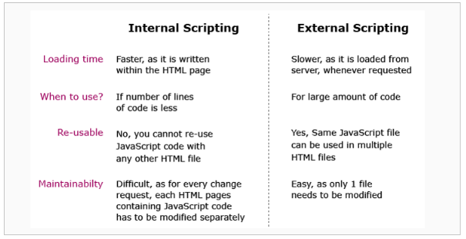

Slide 18
Environmental Setup - Internal
To work with JavaScript, you can use
Editor
(Notepad, Visual Studio Code IDE etc.)
Browser
(Google Chrome, Microsoft Edge etc.)

Slide 19
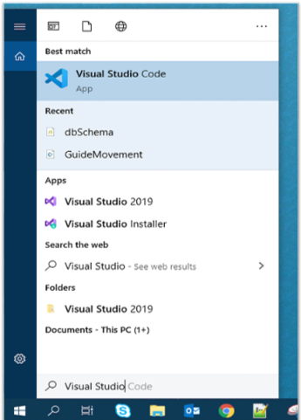
Steps to execute JavaScript code
Open Visual Studio Code from your start menu.

Slide 20
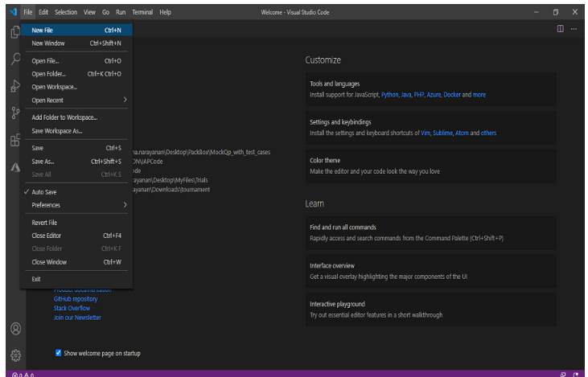
Once Visual Studio Code is launched, Go to the File menu in the Menu bar, select the New File option.

Slide 21
Create the below-mentioned two files (index.js and index.html) and type the below-given code.
index.js file:
console.log("This content is from external JavaScript file");
index.html
<html>
<head>
<title>JavaScript Introduction</title>
<script>
alert("This content is from script tag within <head> tag");
</script>
</head>
<script src="index.js"></script>
<body>
</body>
</html>

Slide 22
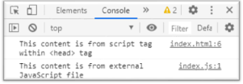
Output:
For the output, copy the index.html file path into the browser. Go to the developer tool in the browser, there in the console option, the output is as shown below:

Slide 23
In the above example, to render the HTML file, the path of the HTML file is copied into the browser. But in this case, each time any changes are done in the code the page must be refreshed for the changes to reflect.
The Visual Studio Code provides an option to add extensions to render the code in a server.

Slide 24
Adding Live Server
Any changes that developers make further will be automatically detected and rendered properly.
Adding Live Server:
1. Go to the extension tab in Visual Studio Code and search for Live Server and click on the install button that is visible in.

Slide 25
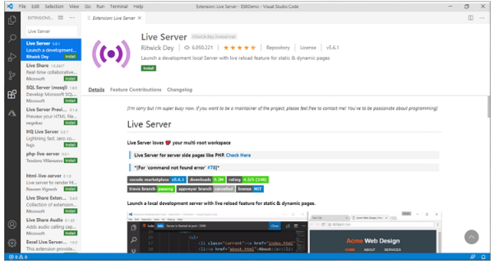

Slide 26
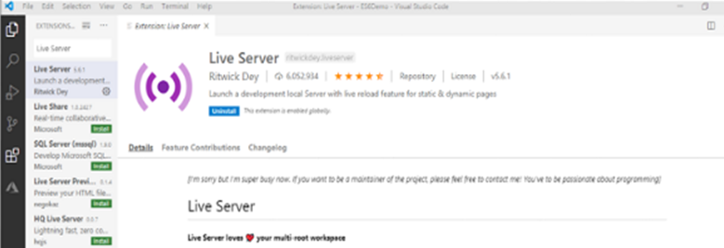
Once it gets installed, there will be a screen with an uninstall button option as shown below and the Live Server is ready to render the HTML pages.

Slide 27
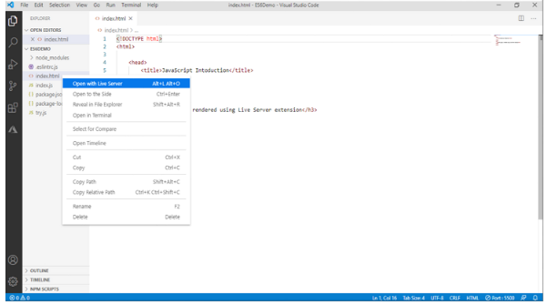
To render an HTML page, right-click on the intended HTML page in the Explore tab and select the ‘Open with Live Server’ option.

Slide 28
Need for Linting
Linting is the process of analyzing the code during development stage to notify the issues or errors in the code.
This helps developer to quickly fix the issues during development and thereby improving the code quality.
ESLint is one of the linting tool used for JavaScript.

Slide 29
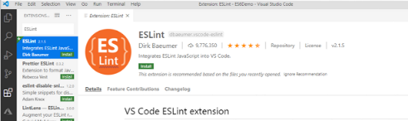
Adding ESLint plugin in VS Code IDE:
Open Visual Studio Code, go to the extension, search for “ESLint”.
Once the ESLint extension appears, hit the “Install” button as shown below:

Slide 30
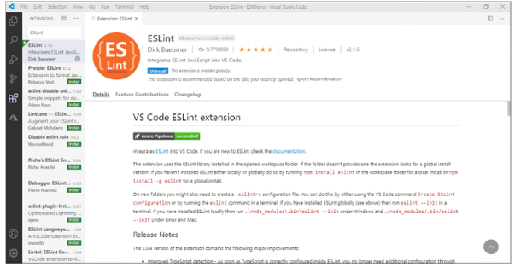
After the installation of ESLint, below screen will be visible:

Slide 31
Adding ESLint using NPM
In order to display the code issues dynamically in the console, we need to install eslint node module from npm repository.
Node.js software needs to be installed in system in order to use npm.
Node.js is a JavaScript runtime environment that executes the JavaScript code outside a web browser.

Slide 32
It has a default package manager called Node Package Manager (npm) which gets installed automatically along with Node.js installation.
npm can be used to install any third-party JavaScript libraries. Here, we are using npm to install eslint for linting purpose.

Slide 33
Following are the steps to configure ESLint with JavaScript.
Create a JavaScript demo.js file with below sample code
let firstName="Rexha"
let lastName ="Bebe";
for( let i=0;i<=5;i--){
console.log(i);
}

Slide 34
Go to the Terminal in the VS code IDE, be in project folder (where the demo.js file is present) path.
Run the below command
npm init
The above command creates a package.json file which will have the metadata and package dependencies for the project.

Slide 35
Now install ESLint using the following command:
npm install eslint --save-dev
Next, is to create the configuration file: “.eslintrc.js”, using one of the below-given command:
./node_modules/.bin/eslint --init
OR
npm init @eslint/config

Slide 36
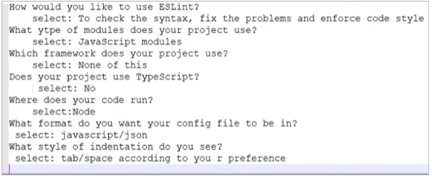
This command will prompt questions on how ESLint is to be used and completes the creation of a configuration file for ESLint.

Slide 37
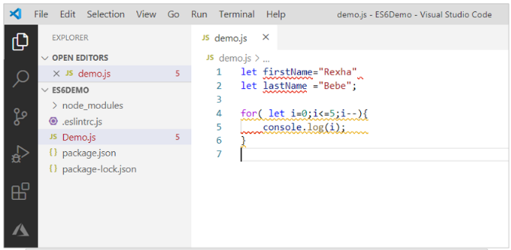
If any linting issue occurs in code, all the issues will be highlighted and more details will be provided in the console as shown below.

Slide 38
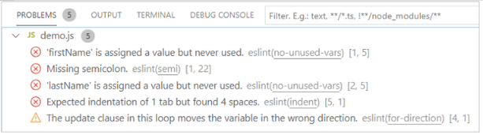

Slide 39
Identifiers
Identifiers are those names that help in naming the elements in JavaScript.
Examples: firstName; placeOfVisit;
Identifiers should follow below rules:
The first character of an identifier should be letters of the alphabet or an underscore (_) or dollar sign ($).
Subsequent characters can be letters of alphabets or digits or underscores (_) or a dollar sign ($).
Identifiers are case-sensitive. Hence, firstName and FirstName are not the same.
Reserved keywords are part of programming language syntax and cannot be used as identifiers.

Slide 40
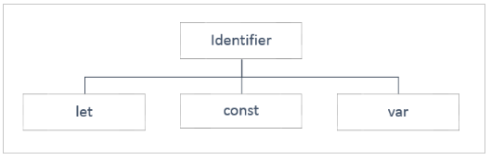
Type of Identifiers
The specific type is based on:
The data which an identifier will hold and
The scope of the identifier

Slide 41
Let
An identifier declared using ‘let’ keyword has a block scope i.e., it is available only within the block in which it is defined.
The value assigned to the identifier can be done either at the time of declaration or later in the code and can also be altered further.

Slide 42
Let
As a best practice, use the let keyword for identifier declarations that will change their value over time or when the variable need not be accessed outside the code block.
For example, in loops, looping variables can be declared using let as they are never used outside the block.

Slide 43
Example
let name="William";
console.log("Welcome to JS course, Mr."+ name);
let name = "Goth";
/* This will throw an error because the identifier 'name' has been already declared and we are redeclaring the variable, which is not allowed using the 'let' keyword. */
console.log("Welcome to JS course, Mr."+name);

Slide 44
Const
The identifier to hold data that does not vary is called 'Constant' and to declare a constant, 'const' keyword is used, followed by an identifier. The value is initialized during the declaration itself and cannot be altered later.
The identifiers declared using 'const' keyword have block scope i.e., they exist only in the block of code within which they are defined.

Slide 45
Example
const pi = 3.14;
console.log("The value of Pi is: "+pi);
pi = 3.141592;
/* This will throw an error because the assignment to a const needs to be done at the time of declaration and it cannot be re-initialized. */
console.log("The value of Pi is: "+pi);

Slide 46
Var
The identifiers declared to hold data that vary are called 'Variables' and to declare a variable, the 'var' keyword is optionally used.
Once the value is initialized, it can be modified any number of times later in the program.
It takes the Function scope i.e., it is globally available to the Function within which it has been declared and it is possible to declare the identifier name a second time in the same function.

Slide 47
Example
var name = "William";
console.log("Welcome to JS course, Mr." + name);
var name = "Goth";
/* Here, even though we have redeclared the same identifier, it will not throw any error.*/
console.log("Welcome to JS course, Mr." + name);

Slide 48

let vs. const vs. var

Slide 49
Data types
It is mandatory for a programming language to know the type of value or the type of data that the variable holds.
The operations or manipulations that must be applied on a variable will be specific to the type of data that a variable will hold.
For example, the result of add operation on two variables will vary based on the data types i.e. numeric or textual.

Slide 50
Data types
Data type mentions the type of value assigned to a variable.
In JavaScript, the type is not defined during variable declaration. Instead, it is determined at run-time based on the value it is initialized with.
Hence, JavaScript language is a loosely typed or dynamically typed language.

Slide 51
Also, there can be same variable of different types in JavaScript code based on the value that is assigned to it.
For example, if let age = 24, the variable 'age' is of type number.
But if, let age = "Twenty-Four", variable 'age' is of type string.
Example:
let age = 24; //number
let name = “Tom” //string
let qualified = true; //boolean

Slide 52
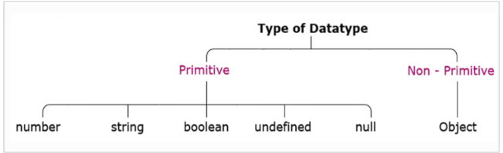

Slide 53
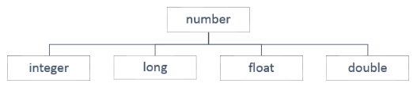
Primitive Data types
The data is said to be primitive if it contains an individual value.
1. Number:
To store a variable that holds a numeric value, the primitive data type number is used.
A number data type gets classified as shown below:

Slide 54
Number
But in JavaScript, the data type number is assigned to the values of type integer, long, float, and double.
For example, the variable with number data type can hold values such as 300, 20.50, 10001, and 13456.89.
Example:
const pi = 3.14; // its value is 3.14
const smallestNaturalNumber = 0;
// its value is 0

Slide 55
In JavaScript, any other value that does not belong to the above-mentioned types is not considered as a legal number.
Such values are represented as NaN (Not-a-Number).
Example:
let result = 0/0; // its value is NaN
let result = "Ten" * 5; //its value is NaN

Slide 56
String
When a variable is used to store textual value.
String values are written in quotes, either single or double.
Example:
let personName= “Rexha”;
//OR
let personName = ‘Rexha’; // both will have its value as Rexha

Slide 57
String
Strings containing single quotes must be enclosed within double quotes and vice versa.
Example:
let ownership= "Rexha's"; //OR
let ownership = 'Rexha"s';
This will be interpreted as Rexha's and Rexha"s respectively. Thus, use opposite quotes inside and outside of JavaScript single and double quotes.

Slide 58
But if you use the same quotes inside a string and to enclose the string:
Example:
let ownership= "Rexha"s"; //OR
let ownership = 'Rexha's';
It is a syntax error.
Thus, remember, strings containing single quotes must be enlosed within double quotes and strings containing double quotes must be enclosed within single quotes.

Slide 59
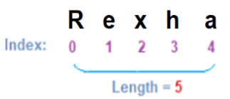
To access any character within the string, it is important to be aware of its position in the string.
The first character exists at index 0, next at index 1, and so on.

Slide 60
Literals
let firstName="Kevin";
let lastName="Patrick";
console.log("Name:"+firstName+” ”+ lastName+”\nEmail:”+firstName+"_"+ lastName+ "@abc.com");
/*OUTPUT:Name: Kevin Patrick Email:Kevin_Patrick@abc.com */
Here, '+' is used for concatenation of identifiers and static content, and '\n' for a new line.

Slide 61
To get the same output, literals can be used as shown below:
let firstName="Kevin";
let lastName="Patrick";
console.log(`Name:${firstName} ${lastName}Email: ${firstName}_${lastName}@abc.com`); /*OUTPUT:Name: Kevin Patrick
Email:Kevin_Patrick@abc.com */
Using template literal, multiple lines can be written in the console.log() in one go.
So, the template literal notation enclosed in ``(backticks) makes it convenient to have multiline statements with expressions and the variables are accessed using ${} notation.

Slide 62
Boolean
Boolean is a data type which represents only two values: true and false.
Values such as 100, -5, “Cat”, 10<20, 1, 10*20+30, etc. evaluates to true whereas 0, “”, NaN, undefined, null, etc. evaluates to false.

Slide 63
Undefined
When the variable is used to store "no value", primitive data type undefined is used.
Example 1:
let custName;
// here value and the data type are undefined
The JavaScript variable can be made empty by assigning the value undefined.
Example 2:
let custName = "John";
// here value is John and the data type is String
custName = undefined;
// here value and the data type are undefined

Slide 64
null
The null value represents "no object".
Example:
let item = null;
// variable item is intended to be assigned with object later. Hence null is assigned during variable declaration.
If required, the JavaScript variable can also be checked if it is pointing to a valid object or null.

Slide 65
BigInt
BigInt is a special numeric type that provides support for integers of random length.
A BigInt is generated by appending n to the end of an integer literal or by calling the function BigInt that generates BigInt from strings, numbers, etc.
Example:
const bigintvar = 67423478234689887894747472389477823647n; OR
const bigintvar = BigInt("67423478234689887894747472389477823647");
const bigintFromNumber = BigInt(10);
// same as 10n

Slide 66
common math operations can be done on BigInt as regular numbers. But BigInt and regular numbers cannot be mixed in the expression.
Example:
alert(3n + 2n); // 5
alert(7n / 2n); // 3
alert(8n + 2); // Error: Cannot mix BigInt and other types
Here the division returns the result rounded towards zero, without the decimal part. Thus, all operations on BigInt return BigInt.

Slide 67
BigInt and regular numbers must be explicitly converted using either BigInt() or Number().
Example:
let bigintvar = 6n;
let numvar = 3;
// number to bigint
alert(bigintvar + BigInt(numvar)); // 9
// bigint to number
alert(Number(bigintvar ) + numvar); // 9
In the above example, if the bigintvar is too large that it won’t fit the number type, then extra bits will be cut off.

Slide 68
Talking about comparison and boolean operations on BigInt, it works fine.
Example:
alert( 8n > 2n ); // true
alert( 4n > 2 ); // true
Even though numbers and BigInts belong to different types, they can be equal ==, but not strictly equal ===.
Example:
alert( 5 == 5n ); // true
alert( 5 === 5n ); // false

Slide 69
When inside if or other boolean operations, BigInts behave like numbers.
Example:
if (0n) { // never executes}
BigInt 0n is falsy, other values are considered to be truthy.
Boolean operators, such as ||, && and others also work perfectly with Bigint’s similar to numbers.
Example:
alert( 1n || 2 ); // 1, here 1n is considered truthy
alert( 0n || 2 ); // 2, here 0n is considered falsy

Slide 70
Non-Primitive data types
The data type is said to be non-primitive if it is a collection of multiple values.
The variables in JavaScript may not always hold only individual values, there are times a group of values are stored inside a variable.
JavaScript gives non-primitive data types named Object and Array, to implement this.

Slide 71
Objects
Objects in JavaScript are a collection of properties and are represented in the form of [key-value pairs].
The 'key' is a string or a symbol and should be a legal identifier.
The 'value‘ can be any JavaScript value like Number, String, Boolean, or another object.
JavaScript provides the number of built-in objects as a part of the language and user-defined JavaScript objects can be created using object literals.

Slide 72
Syntax:
{
key1 : value1,
key2 : value2,
key3 : value3
};
Example:
let mySmartPhone ={
name: "iPhone",
brand: "Apple",
platform: "iOS",
price: 50000 };

Slide 73
Array
To store an ordered collection, which cannot be achieved using the objects.
There are two ways of creating an array:
let dummyArr = new Array();
//OR
let dummyArr = [];

Slide 74
Array
Either array can be declared as empty and can be assigned with value later, or can have the value assigned during the declaration.
Example:
digits =[1,2,3,"four"];
A single array can hold multiple values of different data types.

Slide 75
SCREEN OUTPUT AND KEYBOARD INPUT
ALERT BOX:
Alert box is a very frequently useful to send or write cautionary messages to end user screen.
Alert box is created by alert method of window object as shown below.
Syntax: window. alert (“message”);
When alert box is popup, the user has to click ok to continue browsing or to perform any further operations.

Slide 76
<head>
<script language="JavaScript">
function add( )
{
a=20;
b=40;
c=a+b;
window.alert("This is for addition of 2 no's");
document.write("Result is: "+c);
}
</script>
</head>
<body onload="add( )">
</body>

Slide 77
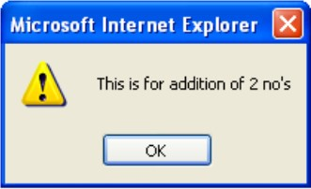
If you press OK, then prints output as: Result is 60.

Slide 78
CONFIRM POPUP BOX
This is useful to verify or accept something from user. It is created by confirm method of window object as shown below.
Syntax:- window.confirm (“message?”);
When the confirm box pop’s up, user must click either ok or cancel buttons to proceed. If user clicks ok button it returns the boolean value true. If user clicks cancel button, it returns the boolean value false.

Slide 79
<head>
<script>
a=50; b=45;
c=a-b;
x=window.confirm("Do you want to see subtraction of numbers");
if(x==true) {
document.write("result is :"+c);
}
else {
document.write("you clicked cancel button");
}
</script>
</HEAD>
<BODY > To see the o/p in pop up box:
</BODY>

Slide 80
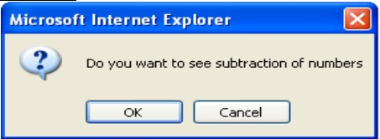
When you click on OK button, it will display result as: Result is: 5 When you click on Cancel button, the control is returned to the browser.

Slide 81
PROMPT POPUP BOX
To accept data from keyboard at runtime. Prompt box is created by prompt method of window object.
Syntax: window.prompt (“message”, “default text”);
When prompt dialog box arises user will have to click either ok button or cancel button after entering input data to proceed. If user click ok button it will return input value. If user click cancel button the value ―null will be returned.

Slide 82
<script>
function fact( )
{
var b=window.prompt("enter +ve integer :","enter here");
var c=parseInt(b);
a=1;
for(i=c;i>=1;i--)
{
a=a*i;
}
window.alert("factorial value :"+a);
}
</script>
</HEAD>
<BODY onload="fact( )">
</BODY>

Slide 83
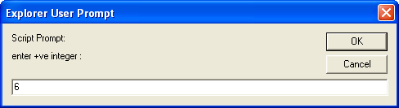
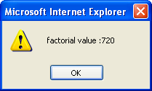

Slide 84
Write ( ) Method:
To write some content or JavaScript code in a Document.
Syntax: document. write (exp1, exp2, exp3, ...);
Here, exp1, exp2, exp3 ….. are all optional arguments.
The writeln() method is identical to the document.write() method, with the addition of writing a newline character after each statement.

Slide 85
<body>
<p>Note that write() does NOT add a new line after each statement:</p>
<script>
document.write("Hello World!"); document.write("Have a nice day!");
</script>
<p>Note that writeln() add a new line after each statement:</p>
<script>
document.writeln("Hello World!"); document.writeln("Have a nice day!");
</script>
</body>

Slide 86
Output:
Note that write() does NOT add a new line after each statement:
Hello World!Have a nice day!
Note that writeln() add a new line after each statement:
Hello World!
Have a nice day!

Slide 87
Operators
The symbols used to perform operations on the values.
Operands: Represents the data.
Operator: Performs certain operations on the operands.
let sum = 5 + 10;
The statement formed using the operator and the operands are called Expression.
In the above example, 5+10 is an expression.
The values are termed as operands.
The symbol ‘+’ is the operator which indicates which operation needs to be performed.

Slide 88
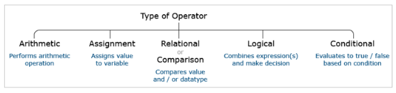
Types of Operators
Operators are categorized into unary, binary, and ternary based on the number of operands on which they operate in an expression.

Slide 89
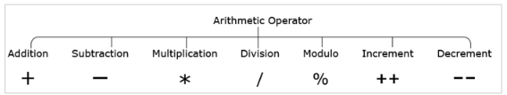
Arithmetic Operators
Arithmetic operators are used for performing arithmetic operations.

Slide 90
let sum = 5 + 3; // sum=8
let difference = 5 – 3; // difference=2
let product = 5 * 3; // product=15
let division = 5/3; // division=1
let mod = 5%3; // mod=2
let value = 5;
value++; // increment by 1, value=6
let value = 10;
value--; // decrement by 1, value=9

Slide 91
Arithmetic Operators – String Type Operands
Arithmetic operator '+' when used with string type results in the concatenation.
let firstName = "James";
let lastName = "Roche";
let name = firstName + " " + lastName;
// name = James Roche

Slide 92
Arithmetic operator ‘+’ when used with a string value and a numeric value, it results in a new string value.
let strValue="James";
let numValue=10;
let newStrValue= strValue + " " + numValue; //newStrValue=James10

Slide 93
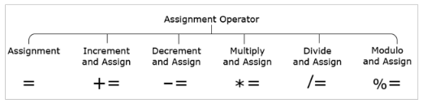
Assignment Operators
Assignment operators are used for assigning values to the variables.
let num = 30; // num=30
let num += 10; // num=num+10 => num=40
let num -= 10; // num=num-10 => num=20
let num *= 30; // num=num*30 => num=900
let num /= 10; // num=num/10 => num=3
let num %= 10; // num=num%10 => num=0

Slide 94
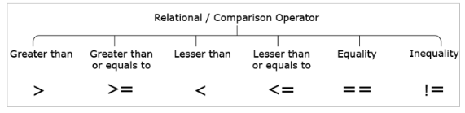
Relational or Comparison Operators
Used for comparing values and the result of comparison is always either true or false.
Relational operators shown below do implicit data type conversion of one of the operands before comparison.

Slide 95
10 > 10; //false
10 >= 10; //true
10 < 10; //false
10 <= 10; //true
10 == 10; //true
10 != 10; //false
Relational operators shown below compares both the values and the value types without any implicit type conversion.

Slide 96
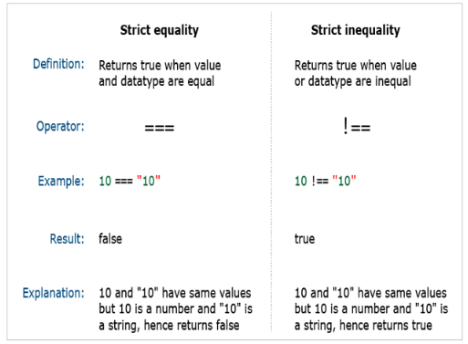

Slide 97
Strict equality (===) and strict inequality (!==) operators consider only values of the same type to be equal.
Hence, strict equality and strict inequality operators are highly recommended to determine whether two given values are equal or not.
As a best practice, you should use === comparison operator when you want to compare value and type, and the rest of the places for value comparison == operator can be used.

Slide 98
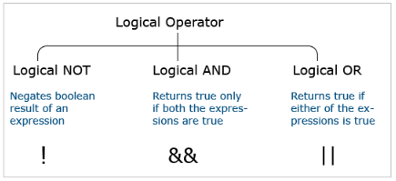
Logical Operators
To make a decision based on multiple conditions. Each operand is considered a condition that can be evaluated to true or false.

Slide 99
Logical Operators
!(10 > 20); //true
(10 > 5) && (20 > 20); //false
(10 > 5) || (20 > 20); //true

Slide 100
typeof Operator
JavaScript is a loosely typed language i.e., the type of variable is decided at runtime based on the data assigned to it. This is also called dynamic data binding.
The typeof operator can be used to find the data type of a JavaScript variable.
typeof "JavaScript World" //string
typeof 10.5 // number
typeof 10 > 20 //boolean
typeof undefined //undefined
typeof null //Object
typeof {itemPrice : 500} //Object

Slide 101
Statements
Statements are instructions in JavaScript that have to be executed by a web browser.
JavaScript code is made up of a sequence of statements and is executed in the same order as they are written.
A Variable declaration is the simplest example of a JavaScript statement.
Syntax:
var firstName = "Newton" ;

Slide 102
Other types of JavaScript statements include conditions/decision making, loops, etc.
White (blank) spaces in statements are ignored.
It is optional to end each JavaScript statement with a semicolon.

Slide 103
Expressions
While writing client-logic in JavaScript, variables and operators are often combined to do computations. This is achieved by writing expressions.
10 + 30; //Evaluates to numeric value
"Hello" + "World"; //Evaluates to string value
itemRating > 5; //Evaluates to boolean value
(age > 60)? "Senior citizen": "Normal citizen";
/*Evaluates to one string value based on whether condition is true or false. If the condition evaluates to true then the first string value "Senior citizen" is assigned otherwise the second string value is assigned "Normal citizen" */

Slide 104
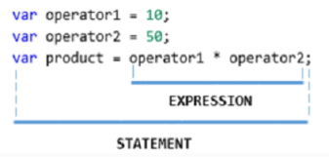

Slide 105
Types of Statements
Conditional Statements: help you to decide based on certain conditions.
These conditions are specified by a set of conditional statements having boolean expressions that are evaluated to a boolean value true or false.
Non-Conditional Statements:
Non-Conditional statements are those statements that do not need any condition to control the program execution flow.

Slide 106
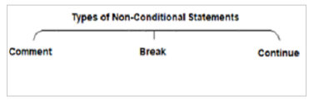
Types of Non-Conditional Statements
Non-Conditional statements are those statements that do not need any condition to control the program execution flow.

Slide 107
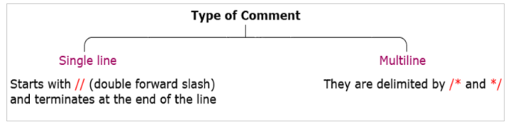
Comments
Used to prevent the execution of a certain lines of code and to add information in the code that explains the significance of the line of code being written.

Slide 108
Example
// Formula to find the area of a circle given its radius
var areaOfCircle = 2 * pi * radius;
/*Formula to find the area of a circle based on given its radius value.*/
var areaOfCircle = 2 * pi * radius;

Slide 109
Break Statement
While iterating over the block of code getting executed within the loop, the loop may be required to be exited if certain condition is met.
The 'break' statement is used to terminate the loop and transfer control to the first statement following the loop.
Syntax:
break;

Slide 110
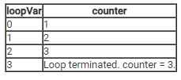
Example- for loop with five iterations which increment variable "counter".
When loop counter = 3, loop terminates.
Also, shown below is the value of the counter and loopVar for every iteration of the loop.
var counter = 0;
for (var loop = 0; loop < 5; loop++) {
if (loop == 3)
break;
counter++;
}

Slide 111
Continue Statement
Continue statement is used to terminate the current iteration of the loop and continue execution of the loop with the next iteration.
Syntax:
continue;

Slide 112
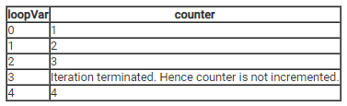
Example- for loop with five iterations which increment variable "counter".
When loop counter = 3, the current iteration is skipped and moved to the next iteration.
var counter = 0;
for (var loop = 0; loop < 5; loop++) {
if (loop == 3)
continue;
counter++;
}

Slide 113
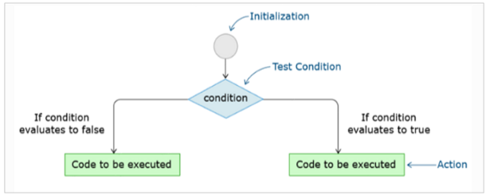
Types of Conditional Statements
Conditional statements help in performing different actions for different conditions.
It is also termed as decision-making statements.

Slide 114
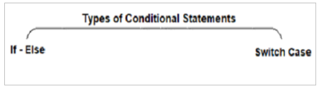
JavaScript supports two decision-making statements:

Slide 115
Ternary operator
It is a conditional operator that evaluates to one of the values based on whether the condition is true or false.
It is a shortcut of 'if-else' condition.
Example:
let workingHours = 9.20;
let additionalHours;
(workingHours > 9.15) ? additionalHours =“You have positive additional hours” : additionalHours = “You have negative additional hours”;
console.log(additionalHours);

Slide 116
If Statements
The 'if' statement evaluates the expression given in its parentheses giving a boolean value as the result.
You can have multiple 'if' statements for multiple choice of statements inside an 'if' statement.
There are different flavors of if-else statement:
Simple 'if' statement
if -else
if–else–if ladder

Slide 117
if statement
To execute a block of code if the given condition evaluates to true.
Syntax:
if (condition) {
// block of code that will be executed, if the condition is true
}
Example:
let num1 = 12;
if (num1 % 2 == 0) {
console.log("It is an even number!!");
}
// OUTPUT: It is an even number!! Because 12%2 evaluates to true

Slide 118
If-else
The 'else' statement is used to execute a block of code if the given condition evaluates to false.
Syntax:
if (condition) {
// block of code that will be executed, if the condition is true
}
else { // block of code that will be executed, if the condition is false
}

Slide 119
Example
let num1 = 1;
if (num1 % 2 == 0) {
console.log("It is an even number!!");
}
else{
console.log("It is an odd number!!");
}
//OUTPUT: It is an odd number!! Because in if 1%2 evaluates to false and moves to else condition

Slide 120
If-else-if Ladder
if...else ladder is used to check for a new condition when the first condition evaluates to false.
Syntax:
if (condition1) {
// block of code that will be executed if condition1 is true
}
else if (condition2) {
// block of code that will be executed if the condition1 is false and condition2 is true
}
else {
// block of code that will be executed if the condition1 is false and condition2 is false
}

Slide 121
Example
let marks = 46;
if (marks >= 85) {
console.log("Very Good");
}
else if (marks < 85 && marks >= 50)
{
console.log("Good");
}
else {
console.log("Needs Improvement");
}
// OUTPUT: Needs Improvement, Because the value of marks is 46 which doesn't satisfy the first two condition checks.

Slide 122
Switch Statement
The Switch statement is used to select and evaluate one of the many blocks of code.
Syntax:
switch (expression) {
case value 1: code block;
break;
case value 2: code block;
break;
case value N: code block;
break;
default: code block;
}
'break' statement is used to come out of the switch and continue execution of statement(s) the following switch.

Slide 123
Switch Statement - with break statement
For the given Employee performance rating (between 1 to 5), displays the appropriate performance badge.
var perfRating = 5;
switch (perfRating) {
case 5: console.log("Very Poor");
break;
case 4: console.log("Needs Improvement"); break;
case 3: console.log("Met Expectations");
break;
case 2: console.log("Commendable");
break;
case 1: console.log("Outstanding");
break;
default: console.log("Sorry!! Invalid Rating.");
}
OUTPUT: Very Poor

Slide 124
Switch Statement - without break statement
var perfRating = 5;
switch (perfRating) {
case 5: console.log("Very Poor");
case 4: console.log("Needs Improvement");
case 3: console.log("Met Expectations");
case 2: console.log("Commendable");
case 1: console.log("Outstanding");
default: console.log("Sorry!! Invalid Rating.");
}

Slide 125
/*
OUTPUT:
Very Poor
Needs Improvement
Met Expectations
Commendable
Outstanding
Sorry!! Invalid Rating.
*/
The reason for the above output is, initially perfRating is checked against case 5 and it got matched, hence ‘Very Poor’ is displayed. But as the break statement is missing, the remaining cases including default got executed.

Slide 126
Switch Statement - default statement
var perfRating = 15;
switch (perfRating) {
case 5: console.log("Very Poor"); break;
case 4: console.log("Needs Improvement"); break;
case 3: console.log("Met Expectations"); break;
case 2: console.log("Commendable"); break;
case 1: console.log("Outstanding"); break;
default: console.log("Sorry!! Invalid Rating.");
}
/* OUTPUT: Sorry!! Invalid Rating. */
Here perfRating = 15 does not match any case values. Hence, the default statement got executed.

Slide 127
Loops
In JavaScript code, specific actions may have to be repeated a number of times.
For example, consider a variable counter which has to be incremented five times.
To achieve this, increment statement can be written five times as shown below:
let counter = 0;
/* Same statement repeated 5 times */
counter++;
counter++;
counter++;
counter++;
counter++;
Looping statements in JavaScript helps to execute statement(s) required number of times without repeating code.
Best Practice: Avoid heavy nesting inside the loops.

Slide 128


Slide 129
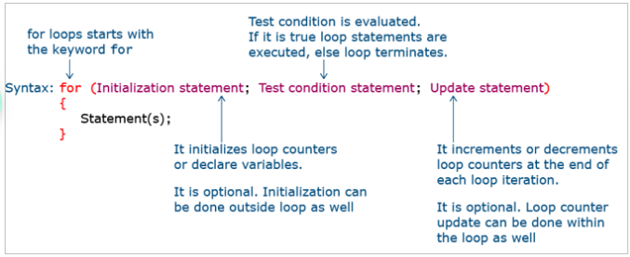
For Loop
'for' loop is used when the block of code is expected to execute for a specific number of times. To implement it, use the following syntax.

Slide 130
Example: incrementing variable counter five times using 'for' loop:
let counter = 0;
for (let loopVar = 0; loopVar < 5; loopVar++) {
counter = counter + 1;
console.log(counter);
}
Here, in the above loop
let loopVar=0; // Initialization
loopVar < 5; // Condition
loopVar++; // Update
counter = counter + 1; // Action
loopVar | Counter
0 | 1
1 | 2
2 | 3
3 | 4
4 | 5

Slide 131
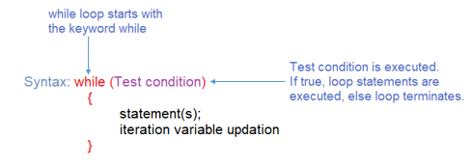
While Loop
'while' loop is used when the block of code is to be executed as long as the specified condition is true.
The value for the variable used in the test condition should be updated inside the loop only.

Slide 132
Example: Incrementing variable counter five times using a 'while' loop.
let counter = 0;
let loopVar = 0;
while (loopVar < 5) {
console.log(loopVar);
counter++;
loopVar++;
console.log(counter);
}
Here, in the above loop
let counter=0; // Initialization
let loopVar=0; // Initialization
loopVar < 5; // Condition
loopVar++; // Update
counter++; // Action
loopVar | counter
0 | 1
1 | 2
2 | 3
3 | 4
4 | 5

Slide 133
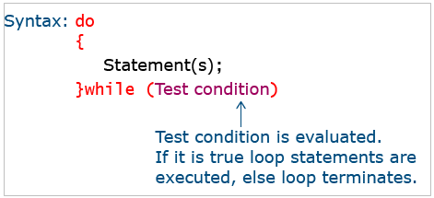
Do-While Loop
'do-while' is a variant of 'while' loop.
This will execute a block of code once before checking any condition.
Then, after executing the block it will evaluate the condition given at the end of the block of code.
The value for the variable used in the test condition should be updated inside the loop only.

Slide 134
Example: incrementing variable counter five times using 'do-while' loop:
let counter = 0;
let loopVar = 0;
do {
console.log(loopVar);
counter++;
loopVar++;
console.log(counter);
}
while (loopVar < 5);
Here, in the above loop
let counter=0; // Initialization
let loopVar=0; // Initialization
loopVar < 5; // Condition
loopVar++; // Update
counter++; // Action
loopVar | counter
0 | 1
1 | 2
2 | 3
3 | 4
4 | 5

Slide 135
Thank You

